Slide 1
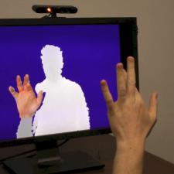
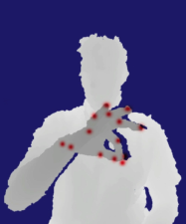
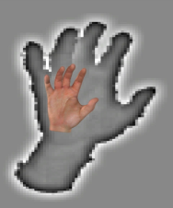
Jonathan Tompson, Murphy Stein, Yann LeCun, Ken Perlin
REAL-TIME CONTINUOUS POSE RECOVERY OF
HUMAN HANDS USING CONVOLUTIONAL NETWORKS
Notes:
Hi I’m Jonathan Tompson, thanks for coming and today.
I’m going to present some work that was carried out by myself and my colleagues at NYU: Murphy Steien, Yann LeCun, Ken Perlin.

Slide 2
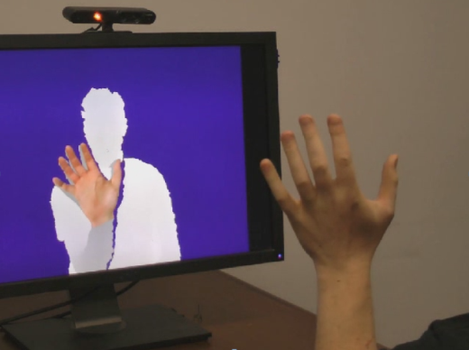
Hand Pose Inference
Target: low-cost markerless mocap
Full articulated pose with high DoF
Real-time with low latency
Challenges
Many DoF contribute to model deformation
Constrained unknown parameter space
Self-similar parts
Self occlusion
Device noise
Notes:
What is our problem?
- Lots of ways to define HAND-TRACKING (finger tip only tracking, joint or skeletal tracking, or non-rigid ICP based tracking, contour based methods)
- We target AR / VR, so
High degrees of freedom and you really need all of them.
Non obvious couplings and constraints between the degrees of freedom that one must really track.

Slide 3
Pipeline overview
Supervised learning based approach
Needs labeled dataset + machine learning
Existing datasets had limited pose information for hands
Architecture
RDF
HAND DETECT
CONVNET JOINT DETECT
IK
POSE
OFFLINE DATABASE CREATION
Notes:
Separate the high level goal into manageable sub-problems
MACHINE LEARNING PHILOSOPHY

Slide 4
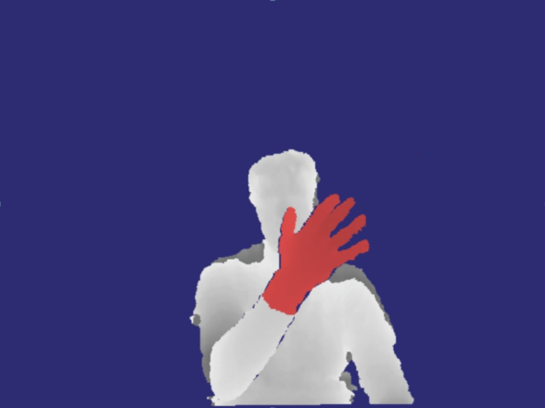
Pipeline overview
Supervised learning based approach
Needs labeled dataset + machine learning
Existing datasets had limited pose information for hands
Architecture
RDF
HAND DETECT
CONVNET JOINT DETECT
IK
POSE
OFFLINE DATABASE CREATION

Slide 5
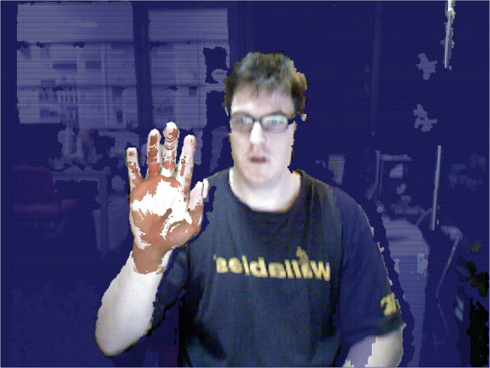
Pipeline overview
Supervised learning based approach
Needs labeled dataset + machine learning
Existing datasets had limited pose information for hands
Architecture
RDF
HAND DETECT
CONVNET JOINT DETECT
IK
POSE
OFFLINE DATABASE CREATION

Slide 6
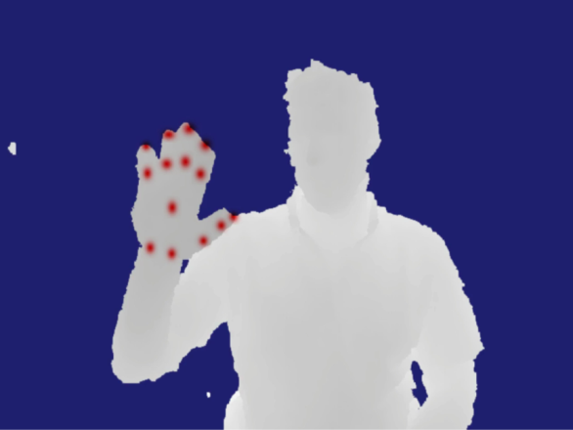
Pipeline overview
Supervised learning based approach
Needs labeled dataset + machine learning
Existing datasets had limited pose information for hands
Architecture
RDF
HAND DETECT
CONVNET JOINT DETECT
IK
POSE
OFFLINE DATABASE CREATION

Slide 7
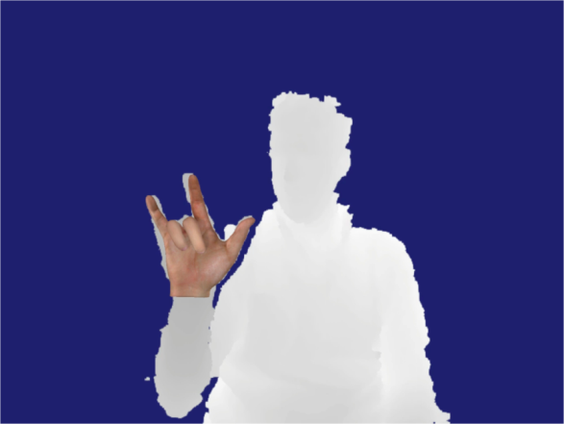
Pipeline overview
Supervised learning based approach
Needs labeled dataset + machine learning
Existing datasets had limited pose information for hands
Architecture
RDF
HAND DETECT
CONVNET JOINT DETECT
IK
POSE
OFFLINE DATABASE CREATION

Slide 8
IMPLEMENTATION

Slide 9
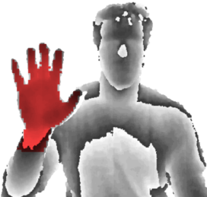
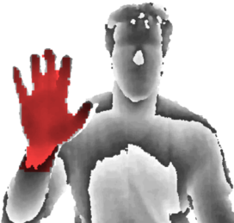
RDF Hand Detection
Per-pixel binary classification → Hand centroid location
Randomized decision forest (RDF)
Shotton et al.^{[1]}
Fast (parallel)
Generalize
Target
Inferred
RDT1
RDT2
+
P(L | D)
Labels
[1] J. Shotten et al., Real-time human pose recognition in parts from single depth images, CVPR 11
Notes:
Following the work at CVPR 2011 by Shotten at al…

Slide 10
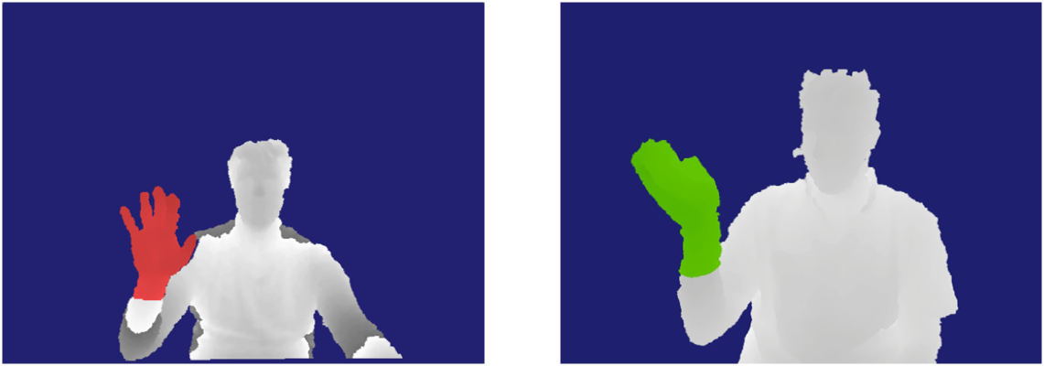
RDF Hand Detection Dataset
7500 images (1000 held as testset)
Training time: approx. 12 hours
Depth 25, 4 trees, 10k WL/node
Dataset
Predicted

Slide 11
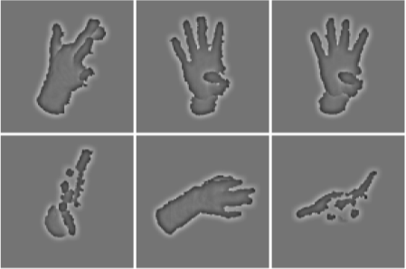
Dataset creation
pose₁
pose₂
pose₃
Goal: labeled RGBD images
{{RGBD₁, pose₁}, {RGBD₂, pose₂}, …}, pose_{i} in R⁴²
Synthetic data doesn’t capture device noise
pose₄
pose₅
pose₆

Slide 12
Dataset creation
pose₁
pose₂
pose₃
Goal: labeled RGBD images
{{RGBD₁, pose₁}, {RGBD₂, pose₂}, …}, pose_{i} in R⁴²
Synthetic data doesn’t capture device noise!
Analysis-by-synthesis from Oikonomidis et al.^{[1]}
pose₄
pose₅
pose₆
[1] I. Oikonomidis et al., Efficient model-based 3D tracking of hand articulations using Kinect, BMVC ‘11

Slide 13
Dataset creation
pose₁
pose₂
pose₃
Goal: labeled RGBD images
{{RGBD₁, pose₁}, {RGBD₂, pose₂}, …}, pose_{i} in R⁴²
Synthetic data doesn’t capture device noise!
Analysis-by-synthesis from Oikonomidis et al.^{[1]}
pose₄
pose₅
pose₆
Render Hypothesis
Evaluate Fit
PSO: search space coverage
NM: fast local convergence
Adjust Hypothesis
Check Termination
[1] I. Oikonomidis et al., Efficient model-based 3D tracking of hand articulations using Kinect, BMVC ‘11

Slide 14
Dataset creation
pose₁
pose₂
pose₃
Goal: labeled RGBD images
{{RGBD₁, pose₁}, {RGBD₂, pose₂}, …}, pose_{i} in R⁴²
Synthetic data doesn’t capture device noise!
Analysis-by-synthesis from Oikonomidis et al.^{[1]}
pose₄
pose₅
pose₆
Render Hypothesis
Evaluate Fit
PSO: search space coverage
NM: fast local convergence
Adjust Hypothesis
Check Termination
[1] I. Oikonomidis et al., Efficient model-based 3D tracking of hand articulations using Kinect, BMVC ‘11

Slide 15
Dataset creation
pose₁
pose₂
pose₃
Goal: labeled RGBD images
{{RGBD₁, pose₁}, {RGBD₂, pose₂}, …}, pose_{i} in R⁴²
Synthetic data doesn’t capture device noise!
Analysis-by-synthesis from Oikonomidis et al.^{[1]}
pose₄
pose₅
pose₆
Render Hypothesis
Evaluate Fit
PSO: search space coverage
NM: fast local convergence
Adjust Hypothesis
Check Termination
[1] I. Oikonomidis et al., Efficient model-based 3D tracking of hand articulations using Kinect, BMVC ‘11

Slide 16
Dataset creation
pose₁
pose₂
pose₃
Goal: labeled RGBD images
{{RGBD₁, pose₁}, {RGBD₂, pose₂}, …}, pose_{i} in R⁴²
Synthetic data doesn’t capture device noise!
Analysis-by-synthesis from Oikonomidis et al.^{[1]}
pose₄
pose₅
pose₆
Render Hypothesis
Evaluate Fit
PSO: search space coverage
NM: fast local convergence
Adjust Hypothesis
Check Termination
[1] I. Oikonomidis et al., Efficient model-based 3D tracking of hand articulations using Kinect, BMVC ‘11

Slide 17
Dataset creation
pose₁
pose₂
pose₃
Goal: labeled RGBD images
{{RGBD₁, pose₁}, {RGBD₂, pose₂}, …}, pose_{i} in R⁴²
Synthetic data doesn’t capture device noise!
Analysis-by-synthesis from Oikonomidis et al.^{[1]}
pose₄
pose₅
pose₆
Render Hypothesis
Evaluate Fit
PSO: search space coverage
NM: fast local convergence
Adjust Hypothesis
Check Termination
[1] I. Oikonomidis et al., Efficient model-based 3D tracking of hand articulations using Kinect, BMVC ‘11

Slide 18
Dataset creation
pose₁
pose₂
pose₃
Goal: labeled RGBD images
{{RGBD₁, pose₁}, {RGBD₂, pose₂}, …}, pose_{i} in R⁴²
Synthetic data doesn’t capture device noise!
Analysis-by-synthesis from Oikonomidis et al.^{[1]}
pose₄
pose₅
pose₆
Render Hypothesis
Evaluate Fit
PSO: search space coverage
NM: fast local convergence
Adjust Hypothesis
Check Termination
[1] I. Oikonomidis et al., Efficient model-based 3D tracking of hand articulations using Kinect, BMVC ‘11

Slide 19
Dataset creation
pose₁
pose₂
pose₃
Goal: labeled RGBD images
{{RGBD₁, pose₁}, {RGBD₂, pose₂}, …}, pose_{i} in R⁴²
Synthetic data doesn’t capture device noise!
Analysis-by-synthesis from Oikonomidis et al.^{[1]}
pose₄
pose₅
pose₆
Render Hypothesis
Evaluate Fit
PSO: search space coverage
NM: fast local convergence
Adjust Hypothesis
Check Termination
[1] I. Oikonomidis et al., Efficient model-based 3D tracking of hand articulations using Kinect, BMVC ‘11

Slide 20
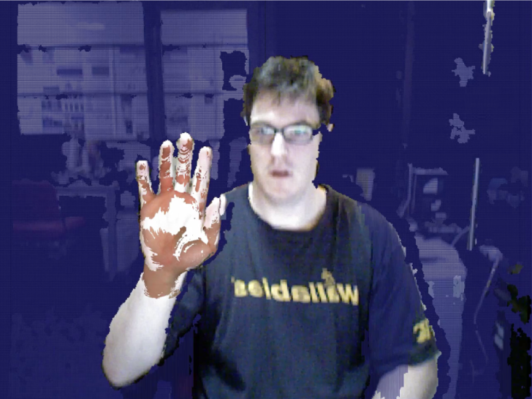
Dataset creation
Training set: 79133 images
Processing time: 4 seconds per frame

Slide 21
Feature Detection – Goal
Infer 2D feature locations
Fingertips, palm, knuckles, etc.
Convolutional network (CN) to perform feature inference
Efficient arbitrary function learner
Reasonably fast using modern GPUs
Self-similar features share learning capacity

Slide 22
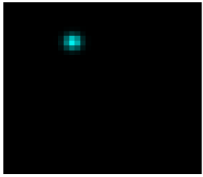
Feature Detection – Heatmaps
CN has difficulty learning (U,V) positions directly
Require learned integration
Possible in theory (never works)
Recast pose-recognition
Learn feature distributions
P_{part1}(x, y)
P_{part2}(x, y)
y
y
x
x

Slide 23
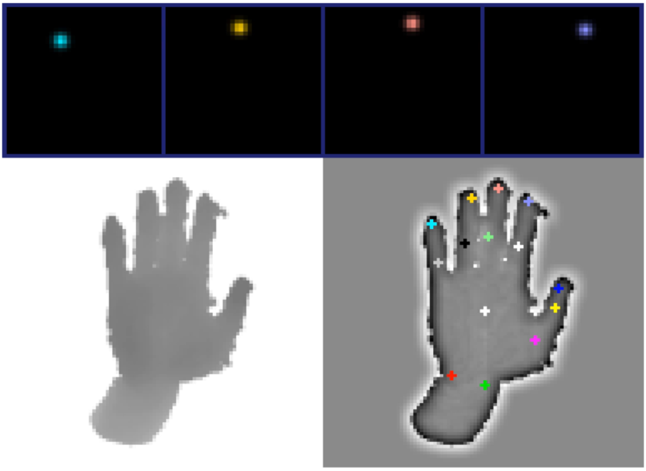
Target Heatmaps
HeatMap1
HeatMap2
HeatMap3
HeatMap4
PrimeSense
Depth
ConvNet
Depth

Slide 24
Detection Architecture
Inspired by Farabet et al. (2013)
Multi-resolution convolutional banks
96x96
Image Preprocessing
48x48
24x24

Slide 25
Detection Architecture
Inspired by Farabet et al. (2013)
Multi-resolution convolutional banks
96x96
ConvNet Detector 1
Image Preprocessing
48x48
ConvNet Detector 2
ConvNet Detector 3
24x24

Slide 26
Detection Architecture
Inspired by Farabet et al. (2013)
Multi-resolution convolutional banks
96x96
ConvNet Detector 1
Image Preprocessing
48x48
ConvNet Detector 2
2 stage Neural Network
ConvNet Detector 3
24x24
HeatMap

Slide 27
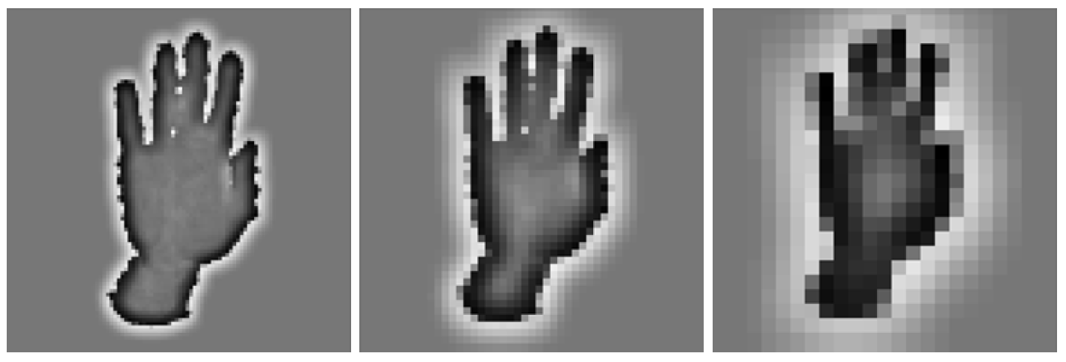
Multi-resolution Convnet
Downsampling (low pass) & local contrast normalization (high pass)
3 x banks with band-pass spectral density
CN convolution filter sizes constant
CN bandwidth context is high without the cost of large (expensive) filter kernels

Slide 28
Inferred Joint positions

Slide 29
Pose Recovery
Convert 2D heat-maps and 3D depth into a 3D skeletal pose → Inverse Kinematics
Fit a 2D Gaussian to the heat-maps (Levenberg-Marquardt)
Sample depth image at the heat-map mean
Fit the model skeleton (least squares) match heat-map locations (resort to 2D when there is no valid depth)

Slide 30
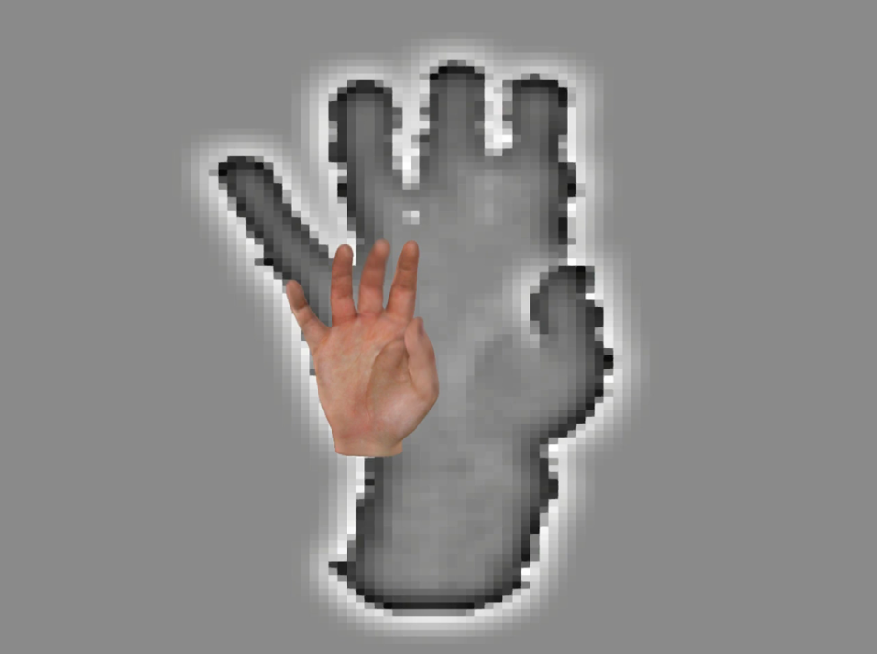
Results
Entire Pipeline: 24.9ms
DF: 3.4ms, CNN: 5.6ms, PSO pose: 11.2ms

Slide 31
Future Work
IK is the weakest part
Can’t learn depth offset or handle occlusions
Needs graphical model or Bayes filter (i.e., extended Kalman)
Two hands (or hand + object) is an interesting direction
ConvNet needs more training data!
More users with higher variety

Slide 32
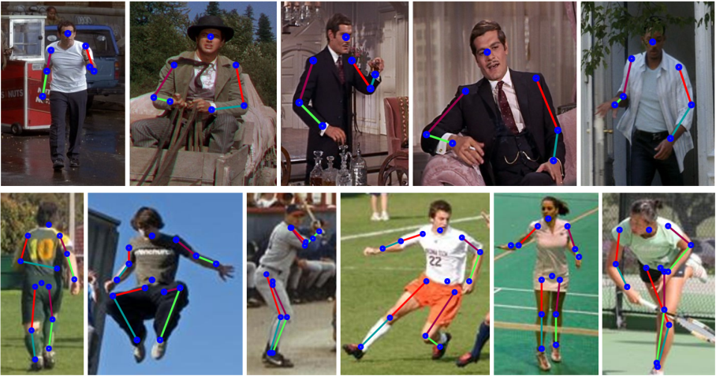
Follow on Work
These techniques work with RGB as well
A. Jain, J. Tompson, M. Andriluka, G. Taylor, C Bregler, Learning Human Pose Estimation Features with Convolutional Networks, ICLR 2014
J. Tompson, A. Jain, Y. LeCun, C. Bregler, Joint Training of a Convolutional Network and a Graphical Model for Human Pose Estimation (submitted & arxiv)

Slide 33
QUESTIONS

Slide 34
APPENDIX

Slide 35
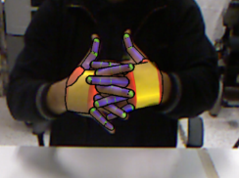
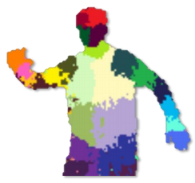
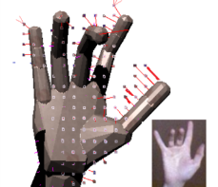
Related Work
Robert Wang et al. (2009, 2011)
Tiny images (nearest-neighbor)
Oikonomidis et al. (2011, 2012)
PSO search using synthetic depth
Shotton et al. (2011)
RDF labels and mean-shift
Melax et al. (2013)
Physics simulation (LCP)
Many more in the paper…
Notes:
Robert Wang:
- Pros: Stable and Fast
- Cons: Discrete poses
Oikonomidis:
- Pros: High DoF & captures difficult poses
- Cons: Slow & unstable
Shotton:
- Pros: Fast & robust to many users
- Cons: No detailed hand-pose
Melax:
- Pros: Fast & stable
- Cons: Limited model & no inference

Slide 36
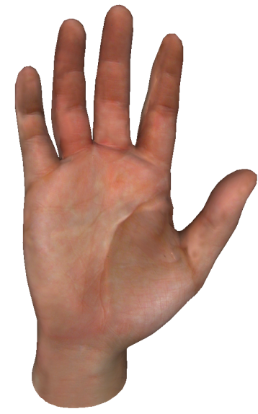
Hand Mesh
LibHand^{[1]} mesh:
67,606 faces
Dual-quaternion blend skinning [Kavan 2008]
42 DoF offline & 23 DoF realtime
Joint angles & twists
Position & orientation
6 DOF
3 DOF
2 DOF
1 DOF
[1] M. Saric. LibHand: A Library for Hand Articulation

Slide 37
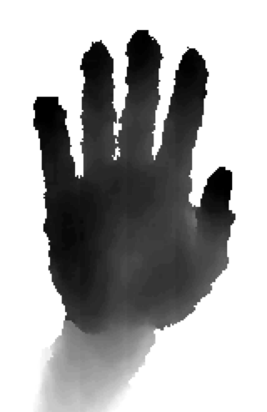
Fitting results
PrimeSense
Synthetic

Slide 38
Pso/nm Objective function
L1 Depth comparison (multiple cameras)
Coefficient prior (out-of-bound penalty)
Interpenetration constraint
Sum of bounding sphere interpenetrations

Slide 39
Multiple Cameras
Calibration was hard
PrimeSense has subtle depth non-linearity
FOVs never match
Shake-n-Sense^{[1]}
We use a variant of ICP
BFGS to minimize Registration Error
Camera extrinsics (T_{i}) doesn’t have to be rigid! (add skew & scale)
[1] A. Butler et al., Shake'N'Sense: Reducing Interference for Overlapping Structured Light Depth Cameras

Slide 40
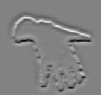
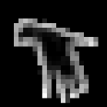
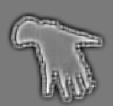
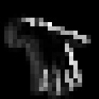
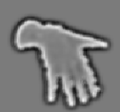
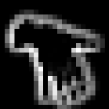
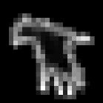
Detection Architecture
Convolutional network feature detector
CNet
LCN
CNet
NNet
CNet
16x92x92
16x23x23
32x22x22
32x9x9
1x96x96
convolution
ReLU + maxpool
convolution
ReLU + maxpool

Slide 41
Detection Architecture
Fully-connected neural network
CNet
LCN
CNet
NNet
CNet
3x32x9x9
7776
14x18x18
Heatmaps
4536
4536
NN
NN + ReLU

Slide 42
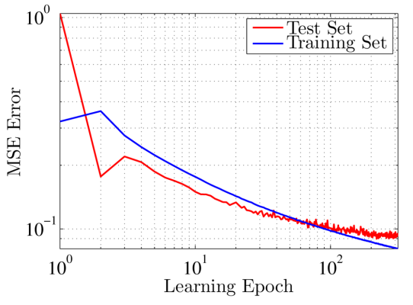
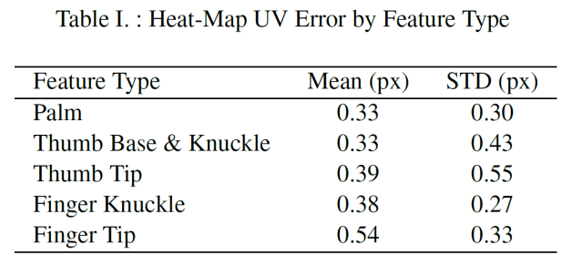
Convnet Performance
Convergence after 350 epochs
Performance per feature type

Slide 43
IK Objective Function
Model to convnet feature error
is a L2 norm in 2D or 3D if there is depth image support for that pixel
Lots of problems... But it works
Use PrPSO to minimize : hard to parameterize and multi-modal (so gradient descent methods fail)
Coefficient bounds prior

